Slide 1
Assessment 2: An analytic task on FIFA World Cup 2026 Goalkeeper Data
Student Details:
Name: Abichal Paudel
Id: s404281
Campus: Darwin

Slide 2
Analytic Question
Do goalkeepers facing above-median shots on target per 90 minutes have a significantly different average save percentage from goalkeepers facing below-median shots on target per 90 minutes during the FIFA World Cup 2026?
Focus: Goalkeeper shot-stopping efficiency
Comparison: High-workload vs low-workload keepers
Test: Two Sample t-test

Slide 3
Methodology
Data Wrangling
Data Preparation
Data Sampling
Descriptive Statistics
Inferential Statistics(Confidence- Interval)
Inferential Statistics(Two Sample t-test)
Tools & Data
import pandas as pd
import numpy as np
from scipy import stats
import matplotlib.pyplot as plt

Slide 4
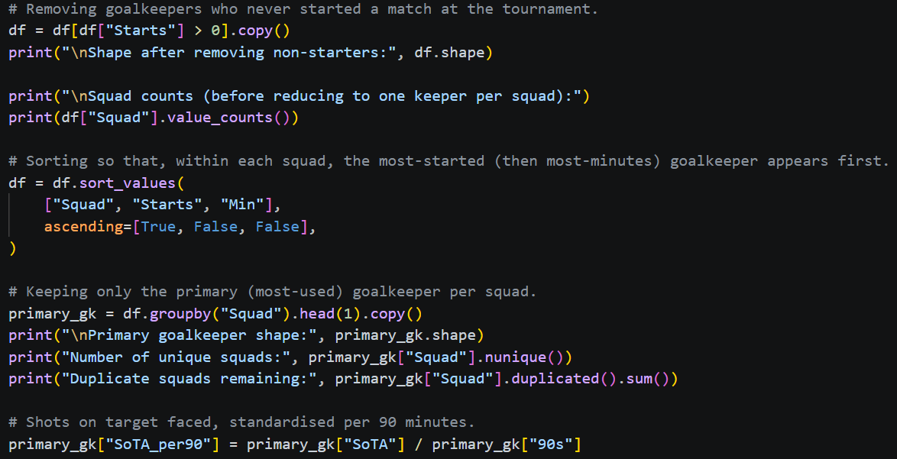
Data Wrangling
Loading: Read the raw CSV using pandas.
Inspecting: Checked shape, columns, information and missing values.
Selecting: Retained Player, POS, Squad, Starts, Min, 90s, SoTA, Saves and Save%.
Filtering: Removed goalkeepers with “Starts=0”.
Sorting: Squad->Starts->Min, descending for Starts and Min.
Grouping: “groupby(Squad).head(1)” selected the most- used goalkeeper per squad.
Result: 48 primary goalkeepers from 48 squads.
Steps:

Slide 5
Data Preparation
Derived Workload Variable
Population
SoTA_per90 = SoTA / 90s
Every primary goalkeeper who started at least one match at the World Cup 2026; one per participating squad.
Standardises shots on target faced across different playing times.
Analysis Variables
Player — goalkeeper identifier
vs
Squad — team identifier
Sample
SoTA_per90 — workload measure (shots faced per 90 min)
Since this population is already small (48 squads), the full population is used as the sample; a census rather than a random subset.
Save% — performance measure (shot-stopping efficiency)
48
observations × 4 variables
0 missing values
4

Slide 6
Data Sampling
Below- Median Group: SoTA/90 < 4.0
Above- Median Group: SoTA/90 > 4.0
Three observations with SoTA/90 exactly equal to 4.0 were excluded by the >/< conditions.
Final Comparison Sample: 45 Goalkeepers
A median split creates two evenly- sized, non- arbitrary groups for comparison; a standard technique when no natural workload threshold exists in the data.

Slide 7
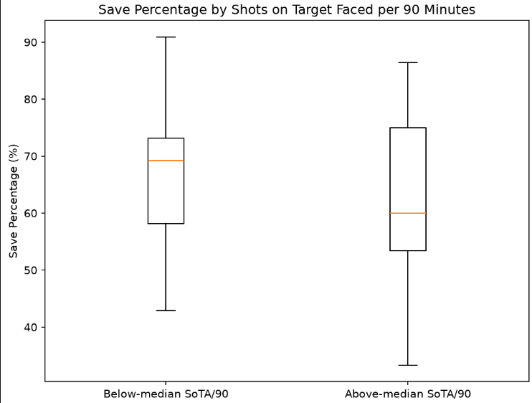
Descriptive Statistics
 | Below - median | Above- median
n | 22 | 23
Mean Save% | 66.70% | 62.13%
Median Save% | 69.2% | 60.0%
Std Dev. | 12.44 | 14.81
The above-median group shows
greater variability in Save%.
Descriptively, higher workload is
associated with a lower average
Save%, but this alone doesn’t
establish statistical significance.

Slide 8
Confidence Interval
Difference in mean Save%(above – below) = -4.58 percentage points
95% Confidence Interval for the difference: (-12.79, 3.64)
This interval contains 0.
A zero difference is therefore plausible based on this interval.
The confidence interval is consistent with the later t- test result.
The analysis used Welch’s approach for the difference in means.
a

Slide 9
Two Sample t-test
Null Hypothesis(H0): mean Save% is equal between the two workload groups.
Alternative Hypothesis(H1): mean Save% is different between the two workload groups.
Two Sample t- test:
Decision: p > α -> Fail to reject H0.
Conclusion: no statistically significant difference detected.
Statistic | Value
t- statistic | -1.12
p- value | 0.267
Degrees of freedom(df) | 42.3
Decision(α = 0.05) | Fail to reject H0

Slide 10
Conclusion
Above- median workload goalkeepers averaged 62.1% of Save%.
Below- median workload goalkeepers averaged 66.7% of Save%.
Observed difference: -4.58 percentage points.
95% CI: -12.79 to 3.64 percentage points.
Two sample t-test: t = -1.12, p = 0.267.
Overall Findings:
The analysis doesn’t provide statistically significant evidence that goalkeeper workload, measured by SoTA per 90, is associated with a different average Save% in this dataset.
Limitations:
The median- tie observations were excluded, leaving 45 goalkeepers for the comparison.

Slide 11
References
Fbref for data collection: https://fbref.com/en/comps/1/keepers/World-Cup-Stats
The pandas development team: https://pandas.pydata.org
Virtanen, P. et al. (2020) SciPy 1.0: fundamental algorithms for scientific computing in Python. Nature methods. [Online] 17 (3), 261–272: https://doi.org/10.1038/s41592-019-0686-2

